Slide 1
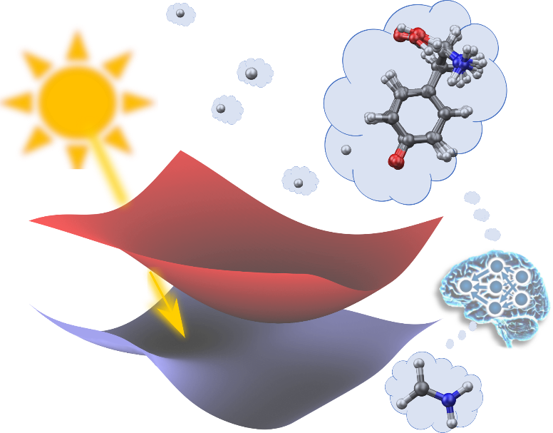
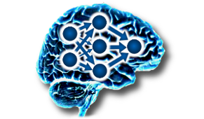

Machine Learning for Surface Hopping Molecular Dynamics: The Case of Excited Tyrosine
Julia Westermayr
Department of Chemistry, University of Warwick
VISTA Webinar
May 26, 2021

Slide 2
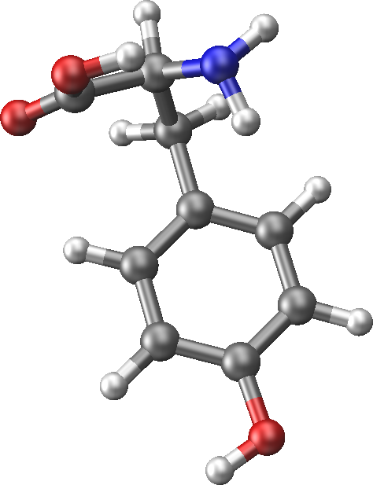

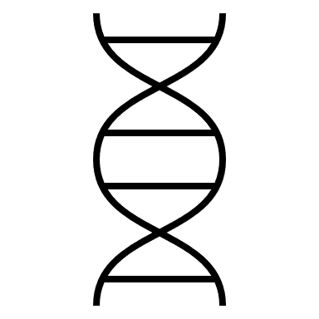




Why are we interested in tyrosine?
Multifaceted photochemistry of peptides and proteins
Experimental evidence for photodissociation after light excitation
Experiments suggest size-dependent photodynamics
Many theoretical studies focus on smaller chromophores
Photosynthesis
Skin alteration
and cancer
Cataracts:
blindness
Drug
alteration
CO₂
sugar
Pattison et al. Photochem. Photobiol. Sci. 11, 38 (2012)
S. P. M. T. Neves-Petersen, G. P. Gajula: UV Light Effects on Proteins: From Photochemistry to Nanomedicine, Molecular Photochemistry, chapter 7,IntechOpen (2012).
Notes:
Proton coupled e-transfer → photosynthesis; dityrosine crosslinking → skin alteration ; No explanation to experimental findings

Slide 3
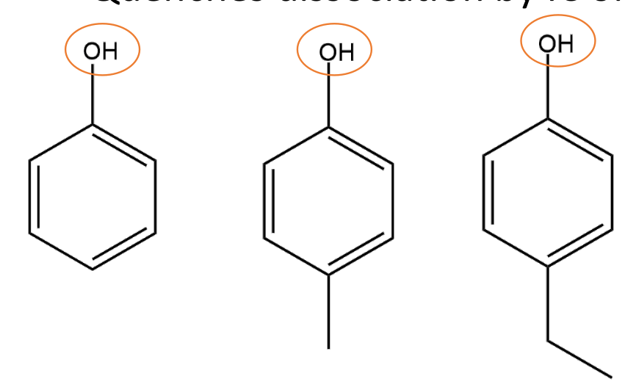
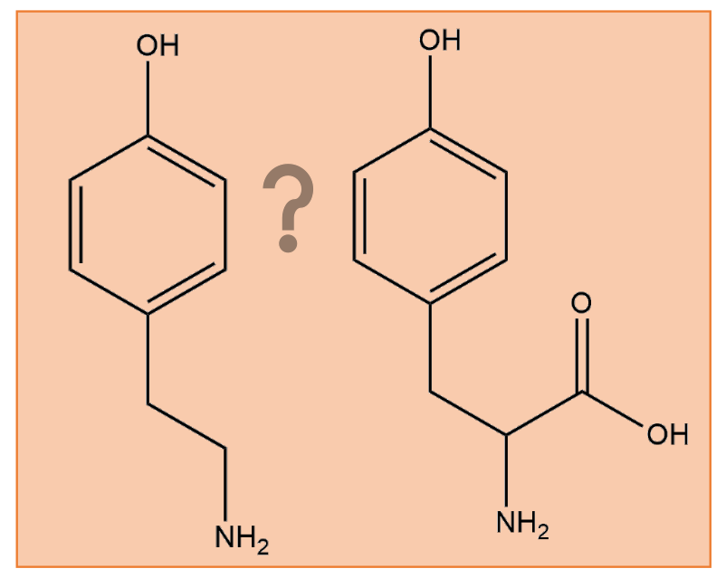

The excited states of tyrosine
What mechanisms lead to different photoproducts in tyrosine?
Goal: complement experiments and shed light on the mechanisms of excited tyrosine
Multifaceted photochemistry of peptides and proteins
Experimental evidence for photodissociation after excitation
Many theoretical studies focus on phenol
Experiments suggest size-dependent photodynamics
CO₂
sugar
Photosynthesis
Skin alteration
and cancer
Cataracts:
blindness
Drug
alteration
Pattison et al. Photochem. Photobiol. Sci. 11, 38 (2012)
S. P. M. T. Neves-Petersen, G. P. Gajula: UV Light Effects on Proteins: From Photochemistry to Nanomedicine, Molecular Photochemistry, chapter 7,IntechOpen (2012).
Notes:
Proton coupled e-transfer → photosynthesis; dityrosine crosslinking → skin alteration ; No explanation to experimental findings

Slide 4

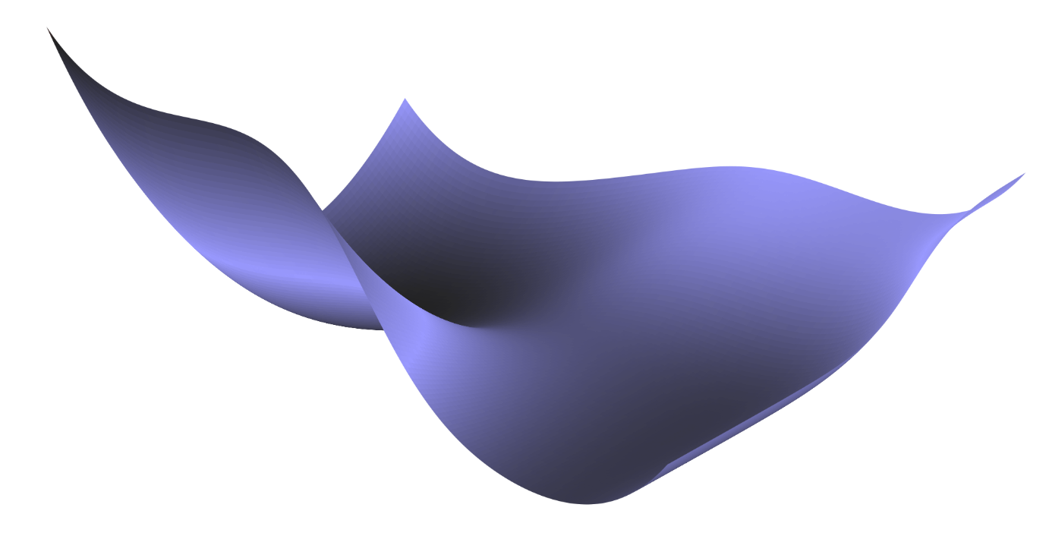
Surface hopping molecular dynamics
Energy
Mixed quantum-classical
Nonadiabatic transitions
Many independent trajectories
Quantum chemical potential energy surfaces
Molecules: move classically
Reaction coordinate

Slide 5
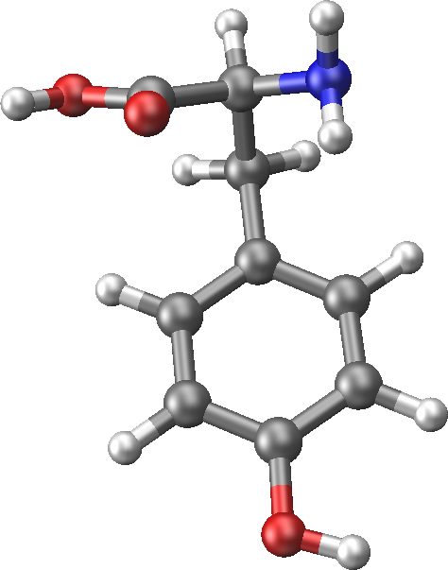


Problem: expensive calculations of potential energy surfacess
Electronic structure
Quantum Chemistry | Accuracy | CPU time QC 1 ps
MS-CASPT2(12,11)/ano-rcc-pVDZ | very high
Quantum Chemistry | Accuracy | CPU time QC 1 ps
MS-CASPT2(12,11)/ano-rcc-pVDZ | very high | ~ 2,910 days x 1000
# Atoms | Quantum Chemistry | CPU time QC 100 fs
24 | MS-CASPT(12,11)/ano-rcc-pVDZ

Slide 6

Problem: expensive calculations of potential energy surfacess
Electronic structure
# Atoms | Quantum Chemistry | CPU time QC 100 fs
24 | MS-CASPT(12,11)/ano-rcc-pVDZ | ~ 291 days x 1000
24 | ADC(2)/dev2-SVP | ~ 1 month x 1000
Quantum Chemistry | Accuracy | CPU time QC 1 ps
MS-CASPT2(12,11)/ano-rcc-pVDZ | very high | ~ 2,910 days x 1000
ADC(2)/def2-SVP | not given for dissociation | ~ 10 months X 1000

Slide 7
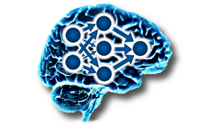

Problem: expensive calculations of potential energy surfacess
Machine learning (ML)
# Atoms | Quantum Chemistry | CPU time QC 100 fs
24 | MS-CASPT(12,11)/ano-rcc-pVDZ | ~ 291 days x 1000
24 | ADC(2)/dev2-SVP | ~ 1 month x 1000
24 | Machine learning | Few min. – hours x 1000
Quantum Chemistry | Accuracy | CPU time QC 100 fs
MS-CASPT(12,11)/ano-rcc-pVDZ | very good | ~ 291 days x 1000
ADC(2)/def2-SVP or TDDFT | Not good for dissociation | ~ 1 month X 1000
Machine learning | ~ Reference | Few min. – hours x 1000
Quantum Chemistry | Accuracy | CPU time QC 1 ps
MS-CASPT2(12,11)/ano-rcc-pVDZ | very high | ~ 2,910 days x 1000
ADC(2)/def2-SVP | not given for dissociation | ~ 10 months X 1000
Machine learning | ~ reference | Few min. – hours x 1000
Can we use ML to enhance photodynamics simulations?

Slide 8
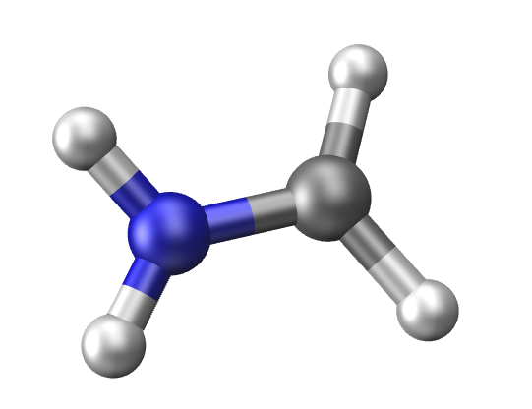
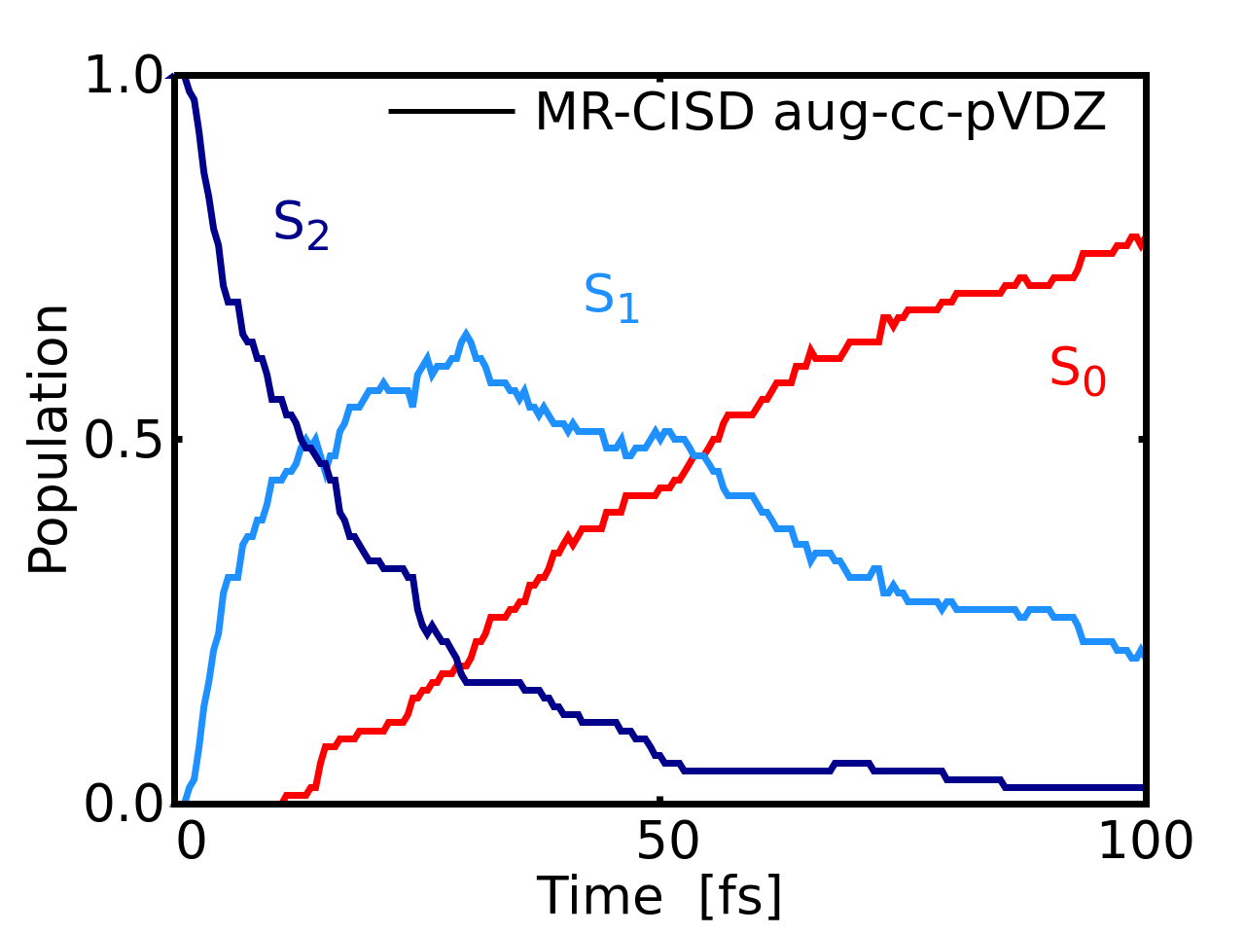



Proof of concept
Methylenimmonium cation, CH₂NH₂⁺
Ultrafast population transfer
MR-CISD/CAS(6,4)/aug-cc-pVDZ
Multi-state neural network model
3 singlet states
Energies + forces
Nonadiabatic couplings
Requirement: comprehensive, accurate potentials with few data points

Slide 9
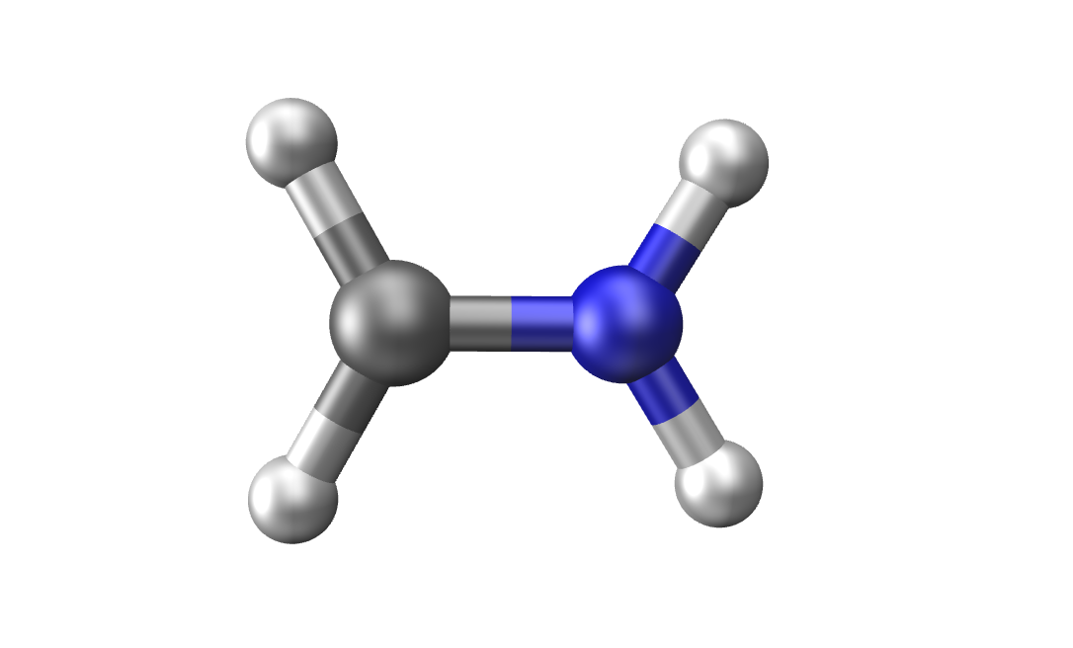
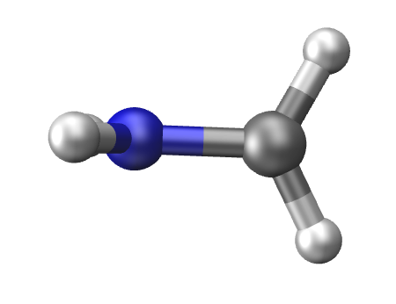
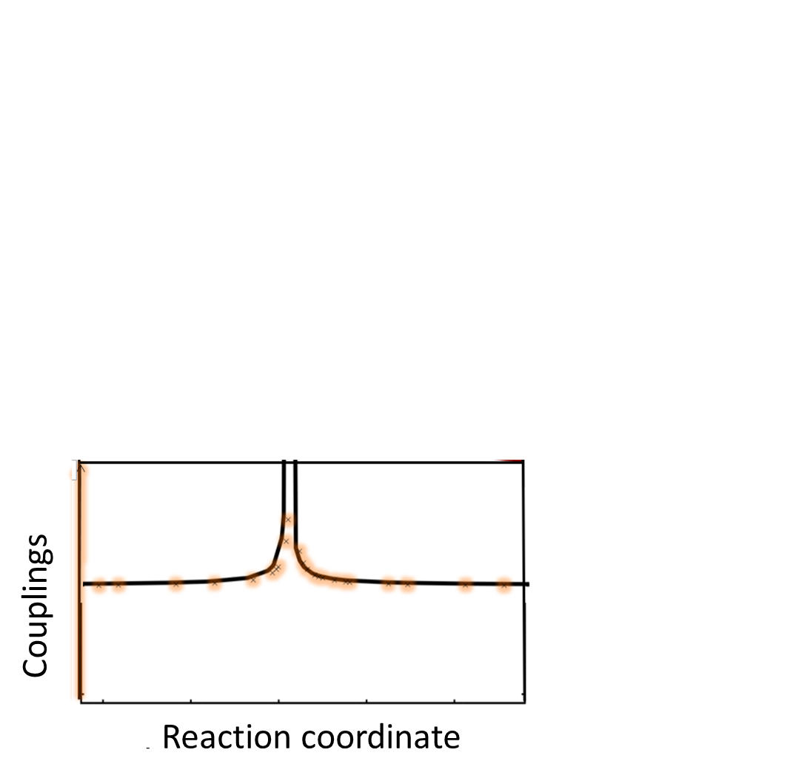
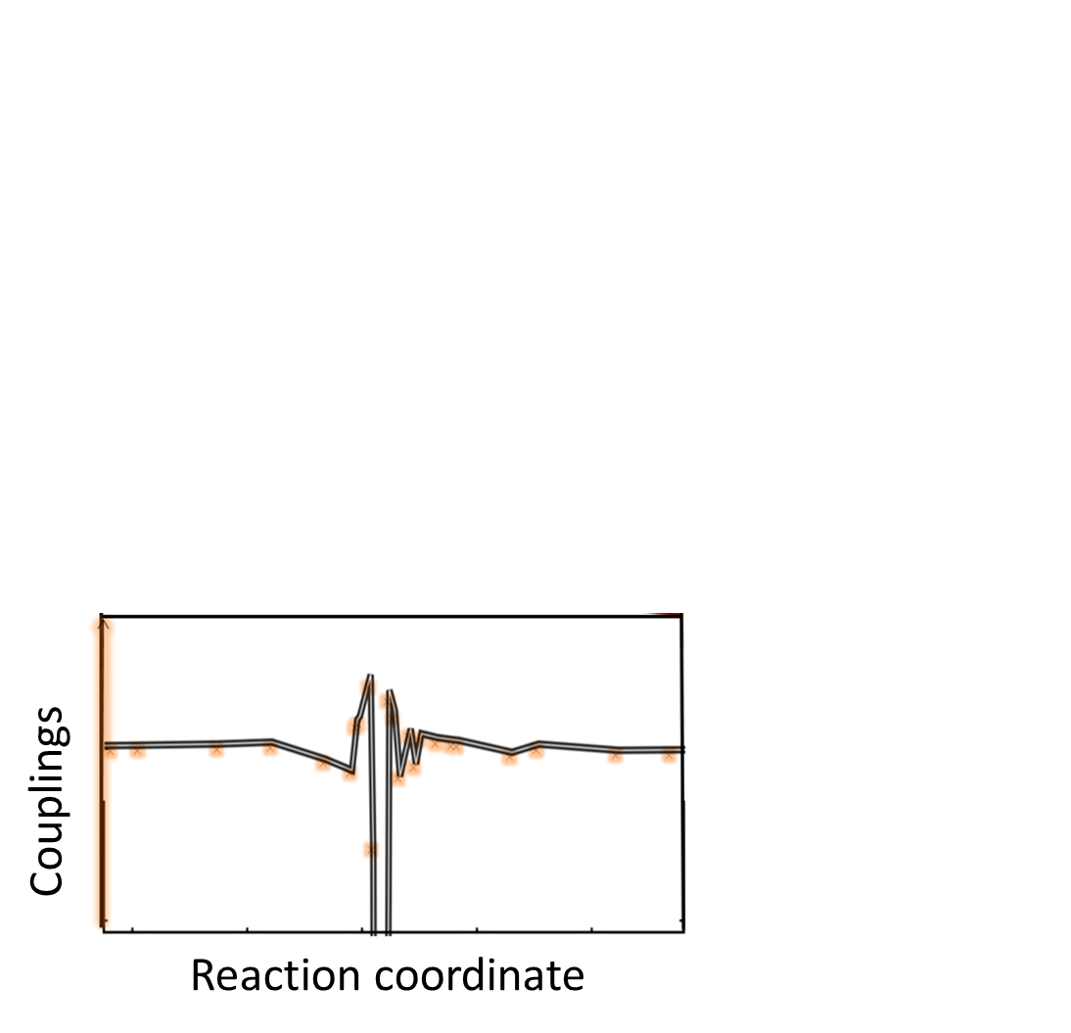
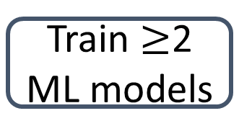
Adaptive sampling^{[1]} for excited states^{[2]}
Initial Data
Correct phases:
1) Phase correction
2) Phase-free training
Train $≥$2 ML models
Molecular
dynamics
Models diverge?
Models diverge?
Yes
Phase correction^{[2,3]}
Reference calculations
Models diverge?
Prediction
Prediction
ML 1
ML 2
STOP
Prediction
ML 1
ML 2
STOP
ML 1
ML 2
STOP
Time
Time
Converged ML potentials
[1] J. Behler, Int. J. Quantum Chem. 115, 1032–1050 (2015) [2] J. Westermayr, et al. Chem. Sci.,10, 8100-8107 (2019).
[3] A. V. Akimov, J. Phys. Chem. Lett., 9(20), 6096.6102 (2018)

Slide 10
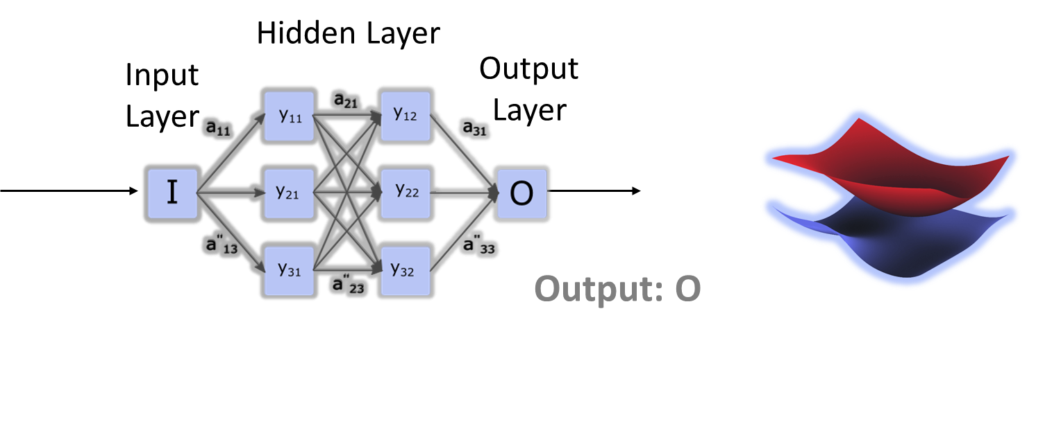
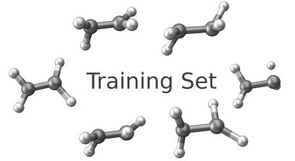
ML photoynamics simulations
Finding a relation between an input and an output
Prediction:
ML photodynamics of CH₂NH₂⁺
Notes:
In principle, we can find any relation we want to. E.g. Human brain fails
Fast/cheap compared to
other methods

Slide 11
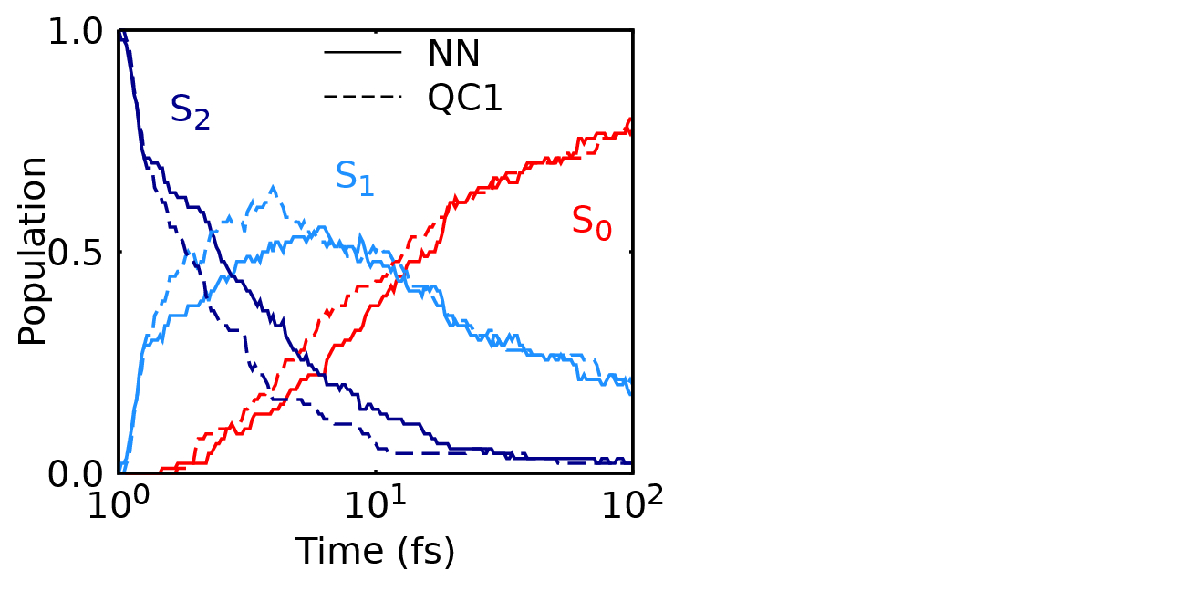
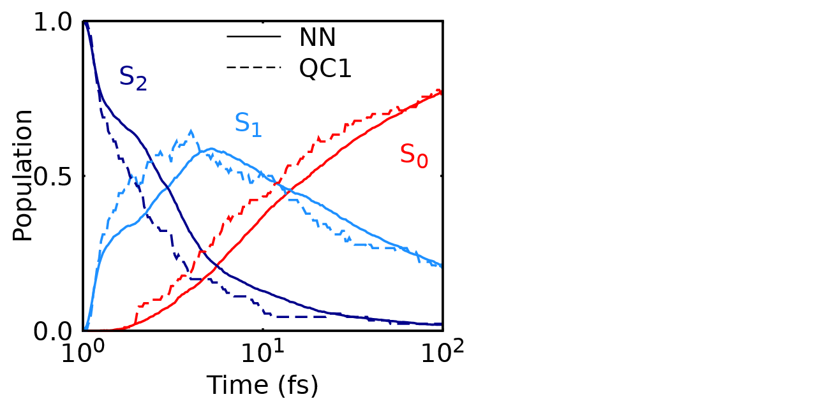
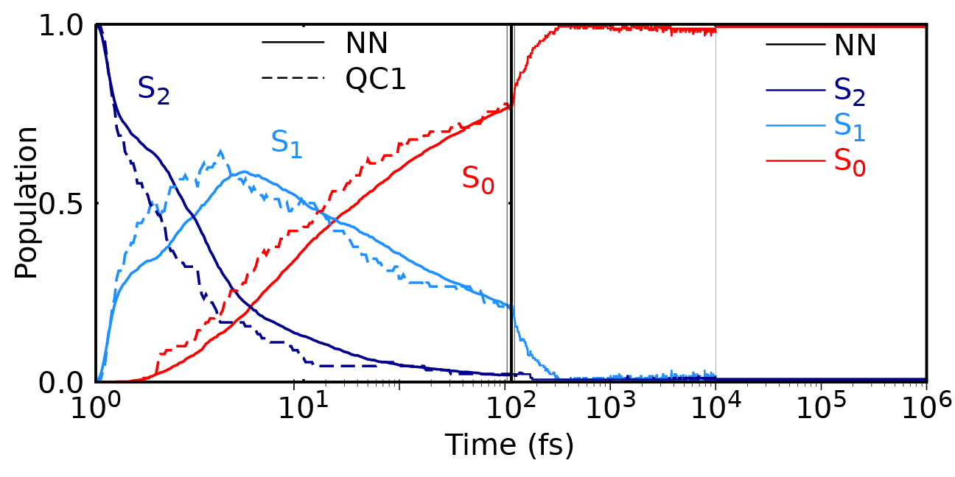
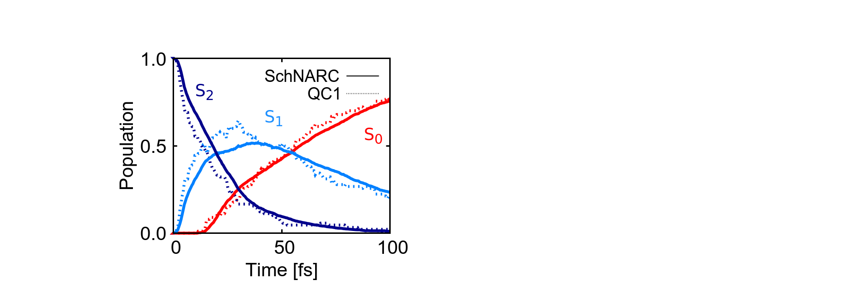

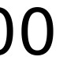
Machine Learning Surface Hopping Molecular Dynamics
ML
ML
Goal for ML:
Reproduce excited state dynamics of QC (100 fs)
Better statistics
Long excited-state dynamics
Timing for 1 ns:
ML: ∼118 times faster
(∼ 59 days; QC: ∼19 years on the same CPU)
QC: MR-CISD/aug-cc-pVDZ
[1] J. Westermayr, M. Gastegger, M. F. S. J. Menger, S. Mai, L. González, P. Marquetand, Chem. Sci.,10, 8100-8107 (2019)

Slide 12





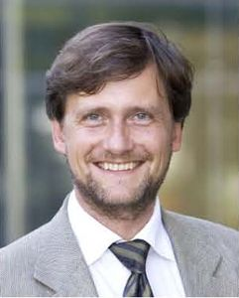
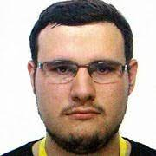
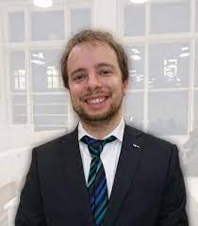
SchNarc approach for photodynamics^{[1]}
Validated for different systems with singlet and triplet states
Application:
The excited states of tyrosine
SHARC^{[1]}
+ SchNet^{[2]}:
SchNarc^{[3]}
[1] https://sharc-md.org/ [2] K. T. Schütt, P. Kessel, M. Gastegger, K. A. Nicoli, A. Tkatchenko, and K.-R. Müller., J. Chem. Theory Comput., 2019, 15(1):448–455. [3] J. Westermayr, M. Gastegger, P. Marquetand, J. Phys. Chem. Lett. 11(10), 3828-3834 (2020).

Slide 13
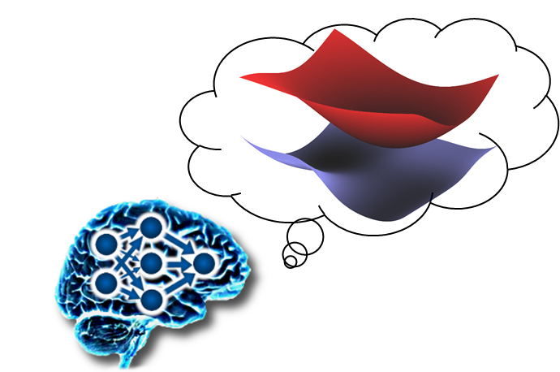
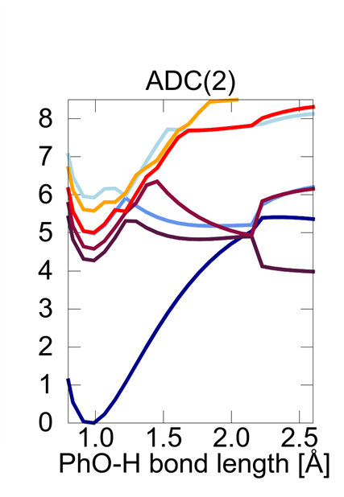
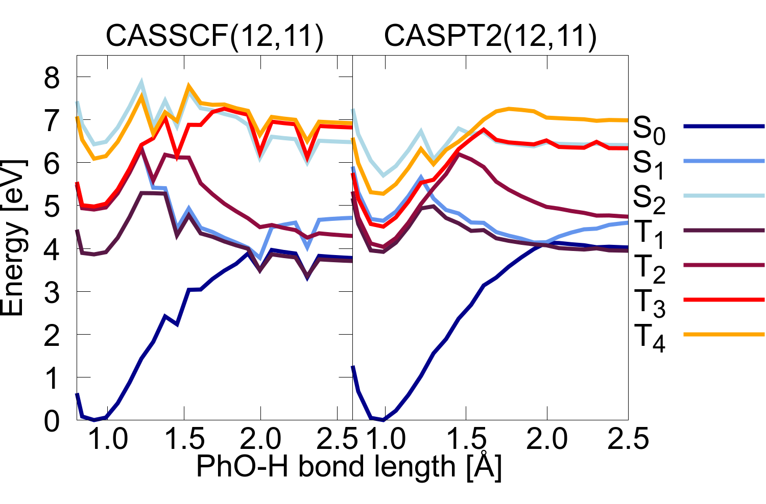
Application of SchNarc
Trainingset generation: which reference method?
Multireference
Singlereference
Potential energy curves: not smooth functions
J. Westermayr et al., unpublished (2021).

Slide 14
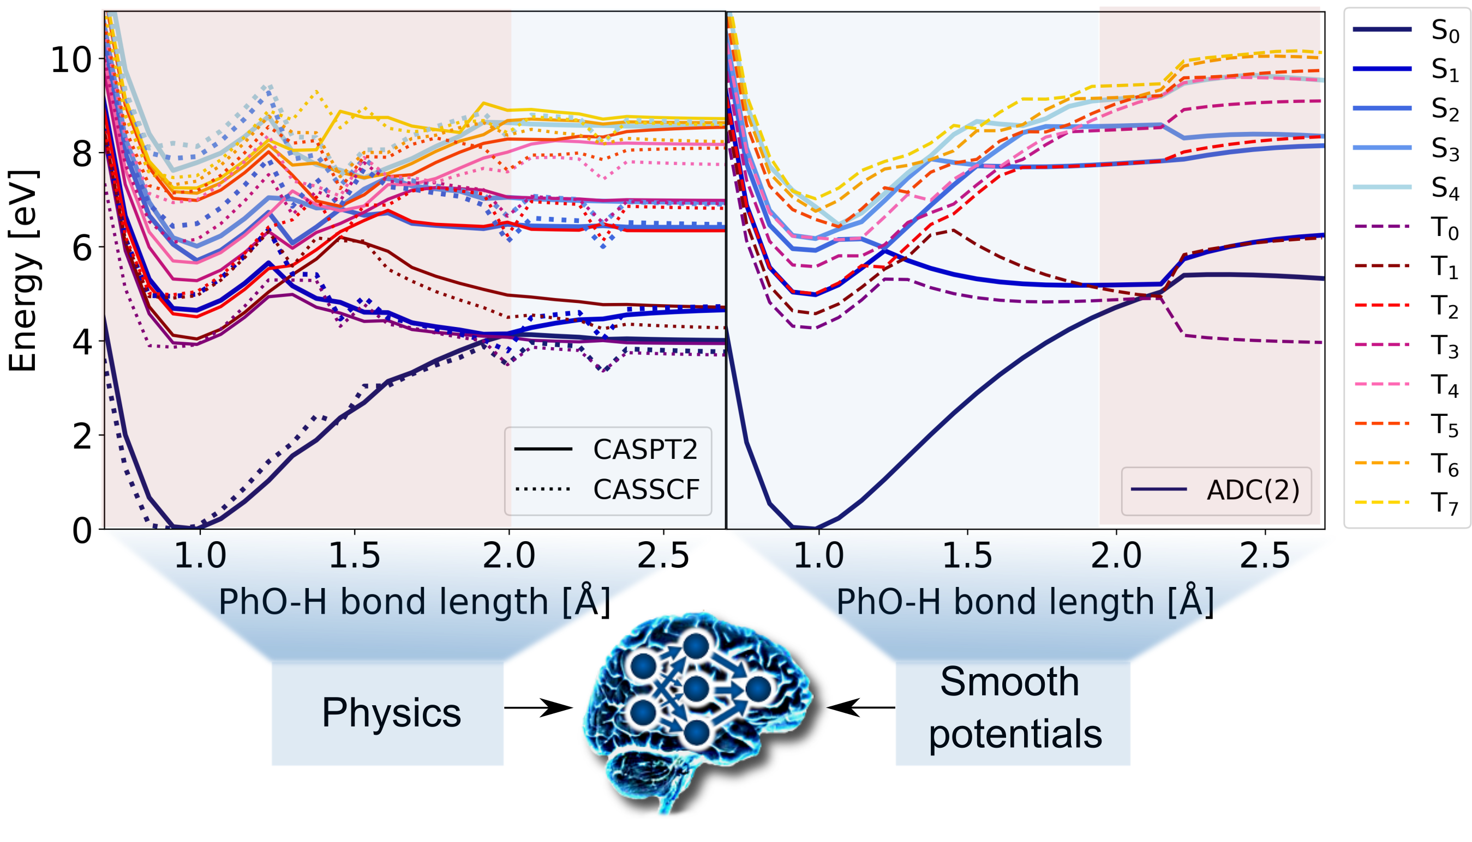
Combine the best of both methods
J. Westermayr et al., unpublished (2021).

Slide 15


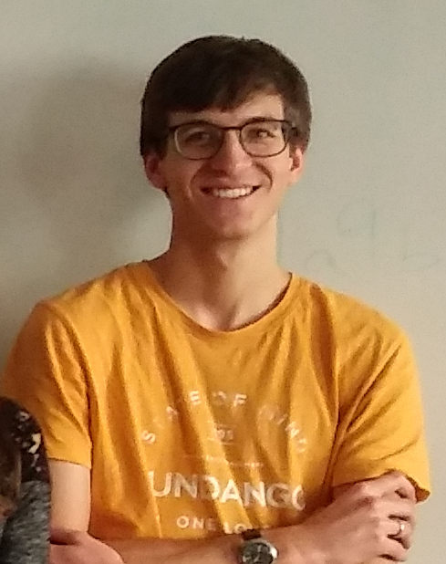
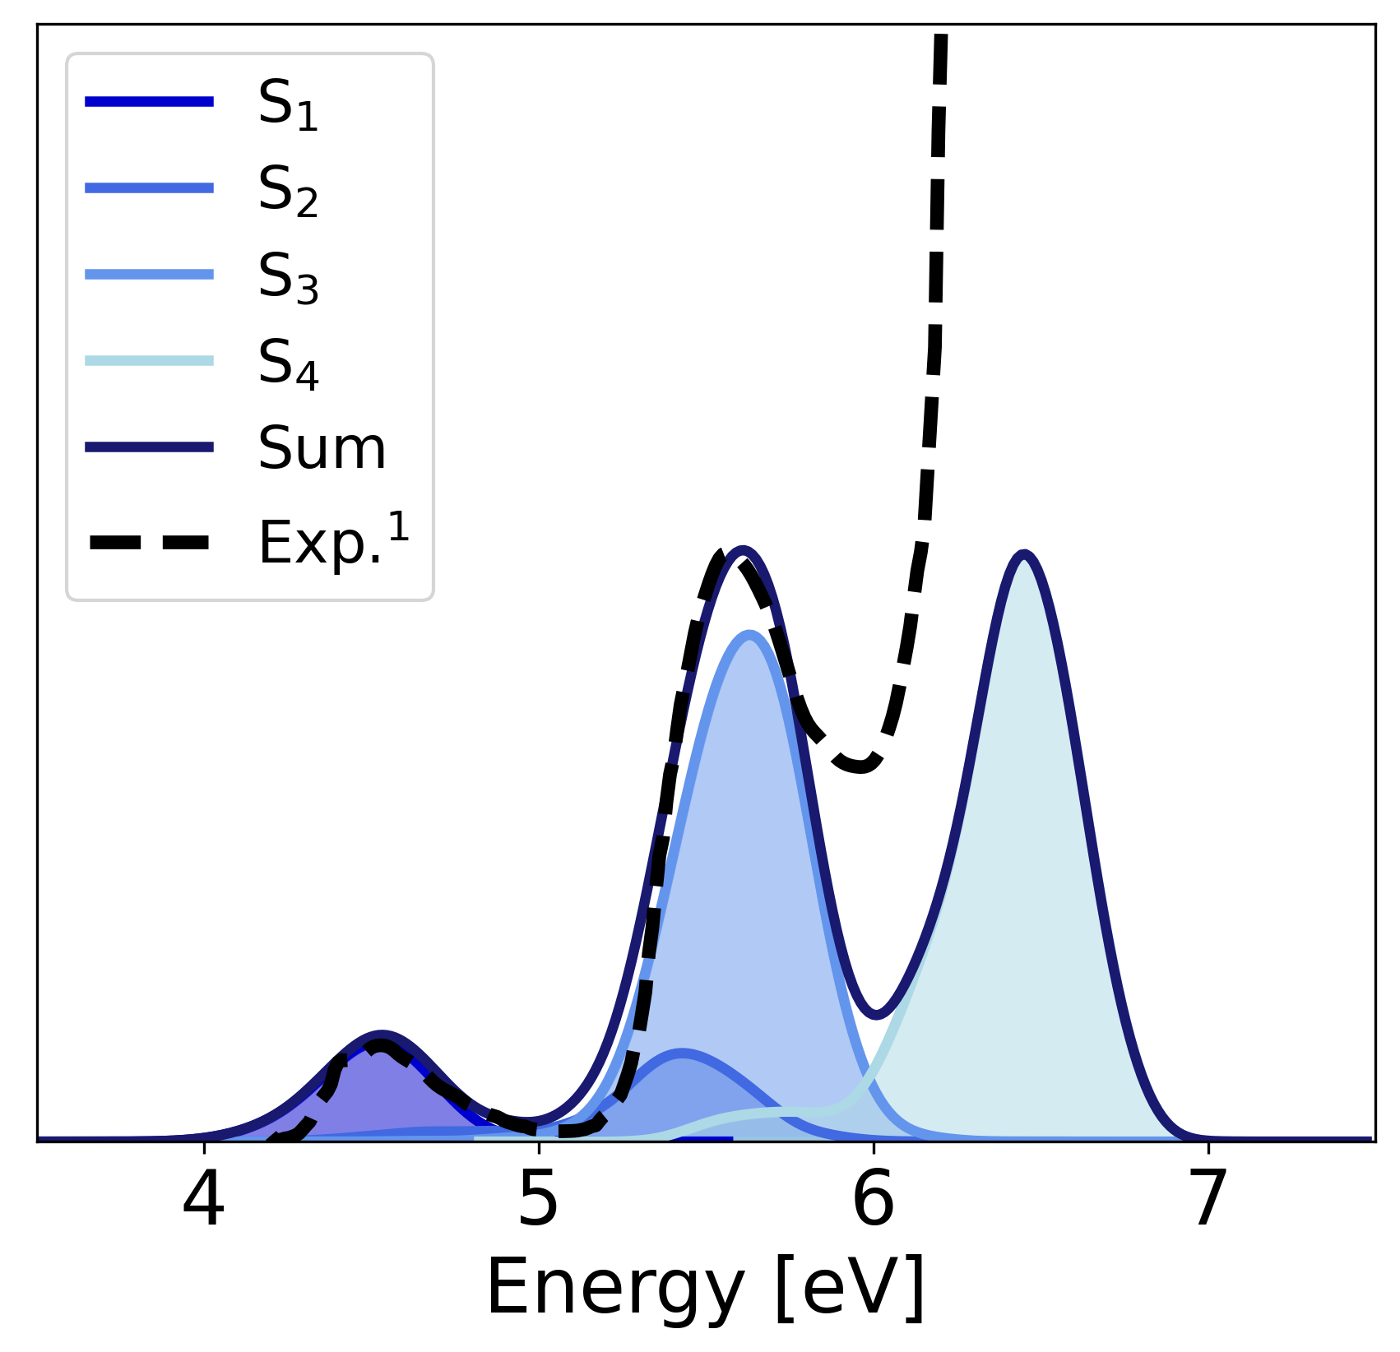

ML for excited states of tyrosine
Training set generation: 17,265 data points
Initial sampling + adaptive sampling (6 rounds)
Phasecorrected data
5 singlets, 8 triplets
Photodynamics:
Excitation to S₄
3 NNs during dynamics
1022 trajectories up to 10 ps
D. Vörös L. Panzenböck
F. Jörg
Energies and forces
$$≅$$
Spin-orbit couplings
J. Westermayr et al., unpublished (2021).

Slide 16

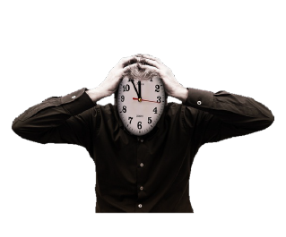

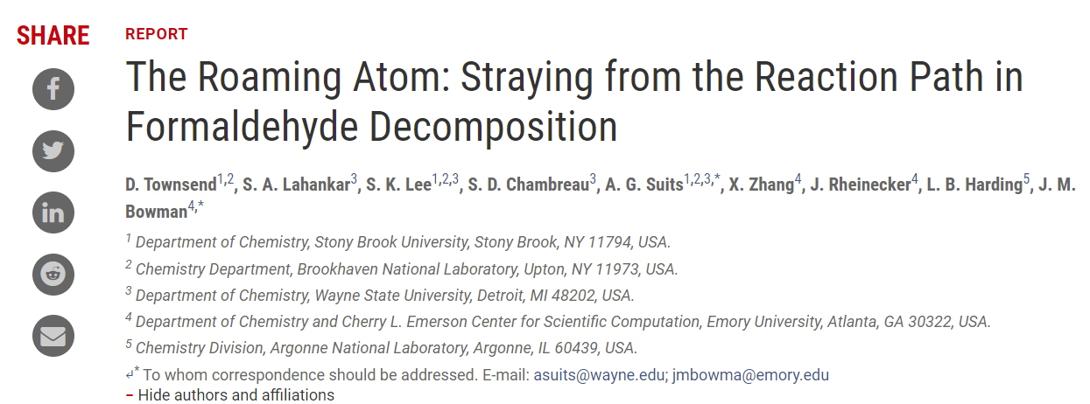
Photodynamics of tyrosine
D. Townsend, et al., Science 306, 5699, 1158-1161 (2004).

Slide 17
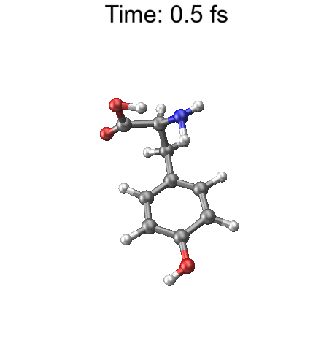
Roaming in tyrosine
Validated with CASPT2(12,11)/ano-rcc-pVDZ
Energetically favored path compared to dissociation
J. Westermayr et al., unpublished (2021).

Slide 18
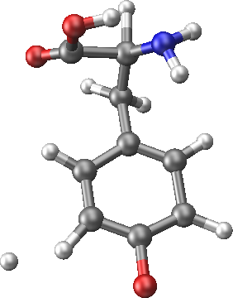
Roaming in tyrosine
Validated with CASPT2(12,11)/ano-rcc-pVDZ
Energetically favored path compared to dissociation
Found about 17% roaming
Unsupervised ML for analysis of 1022 trajectories:
Extract important features from roaming and non-roaming trajectories
J. Westermayr et al., unpublished (2021).

Slide 19
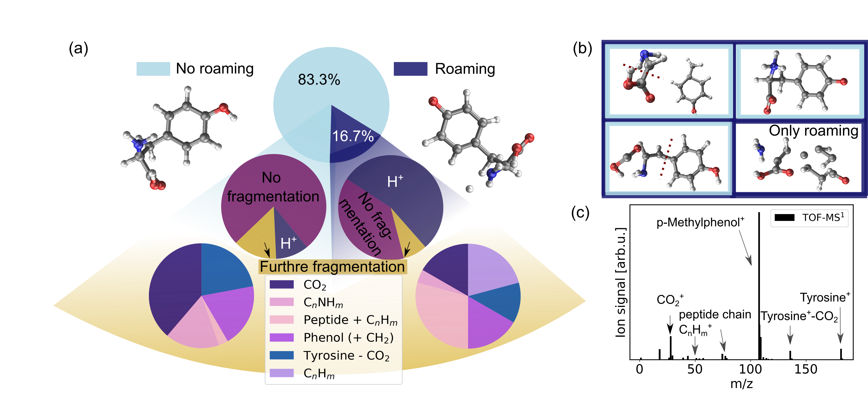
Roaming in tyrosine
No roaming: 10% H dissociation, 14% fragmentation
Roaming: 50% H dissociation, 25% fragmentation
Clusters found with unsupervised learning:
J. Westermayr et al., unpublished (2021).
Mass spectrum extracted from A. Iqbal, PhD thesis, University of Warwick (2010).

Slide 20
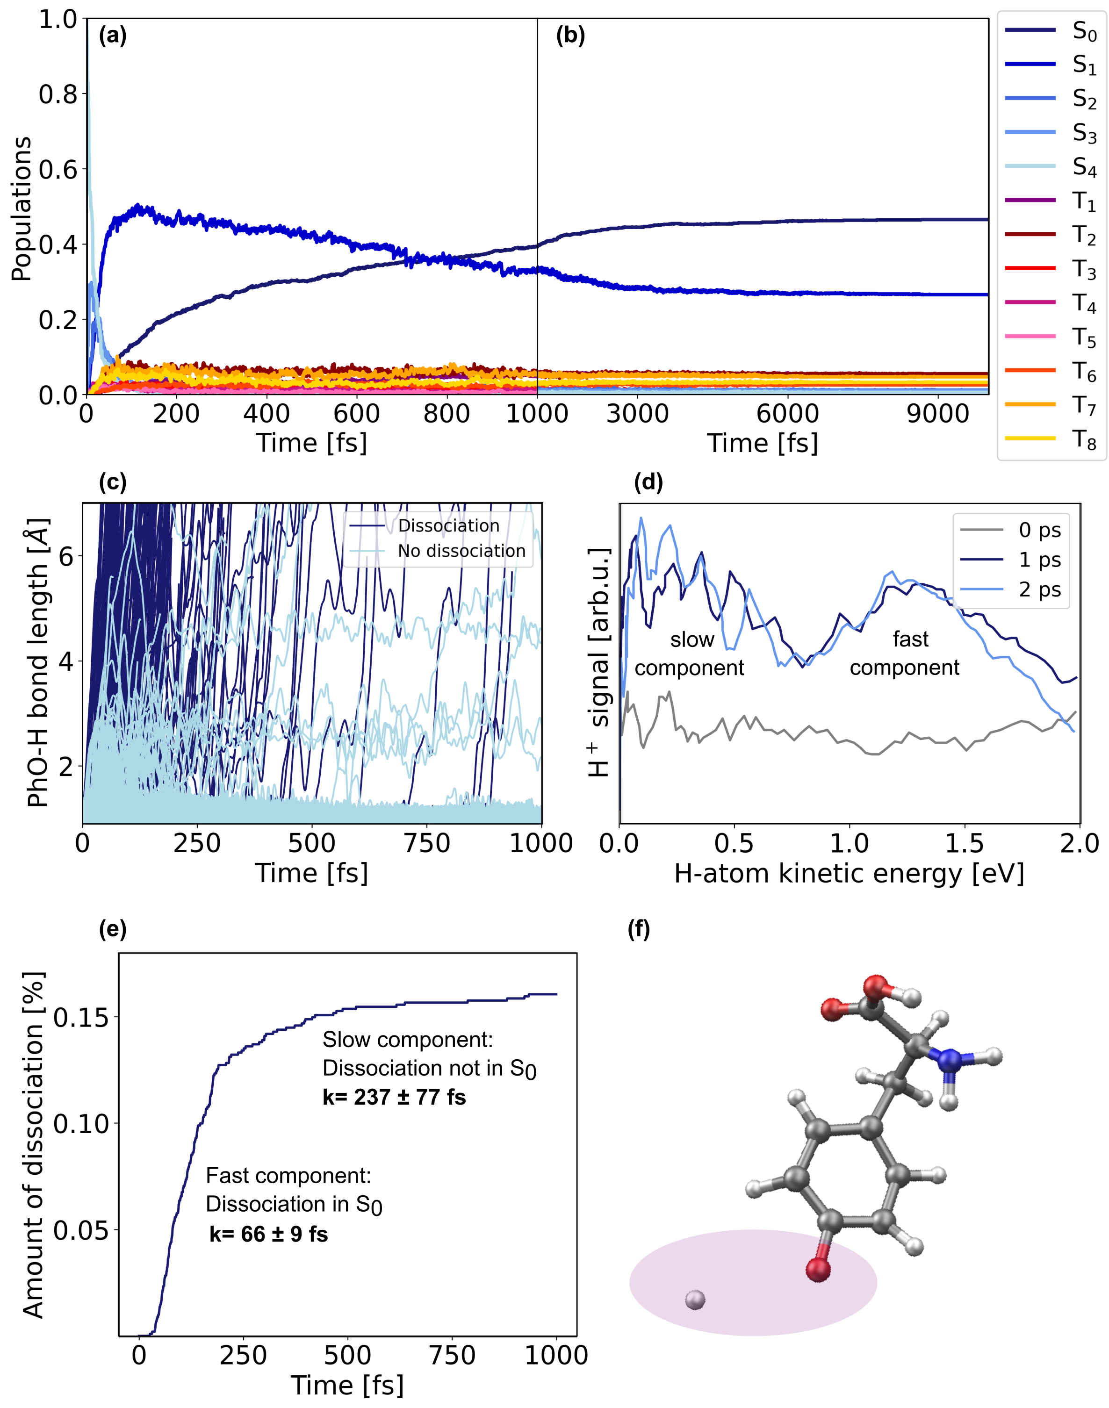
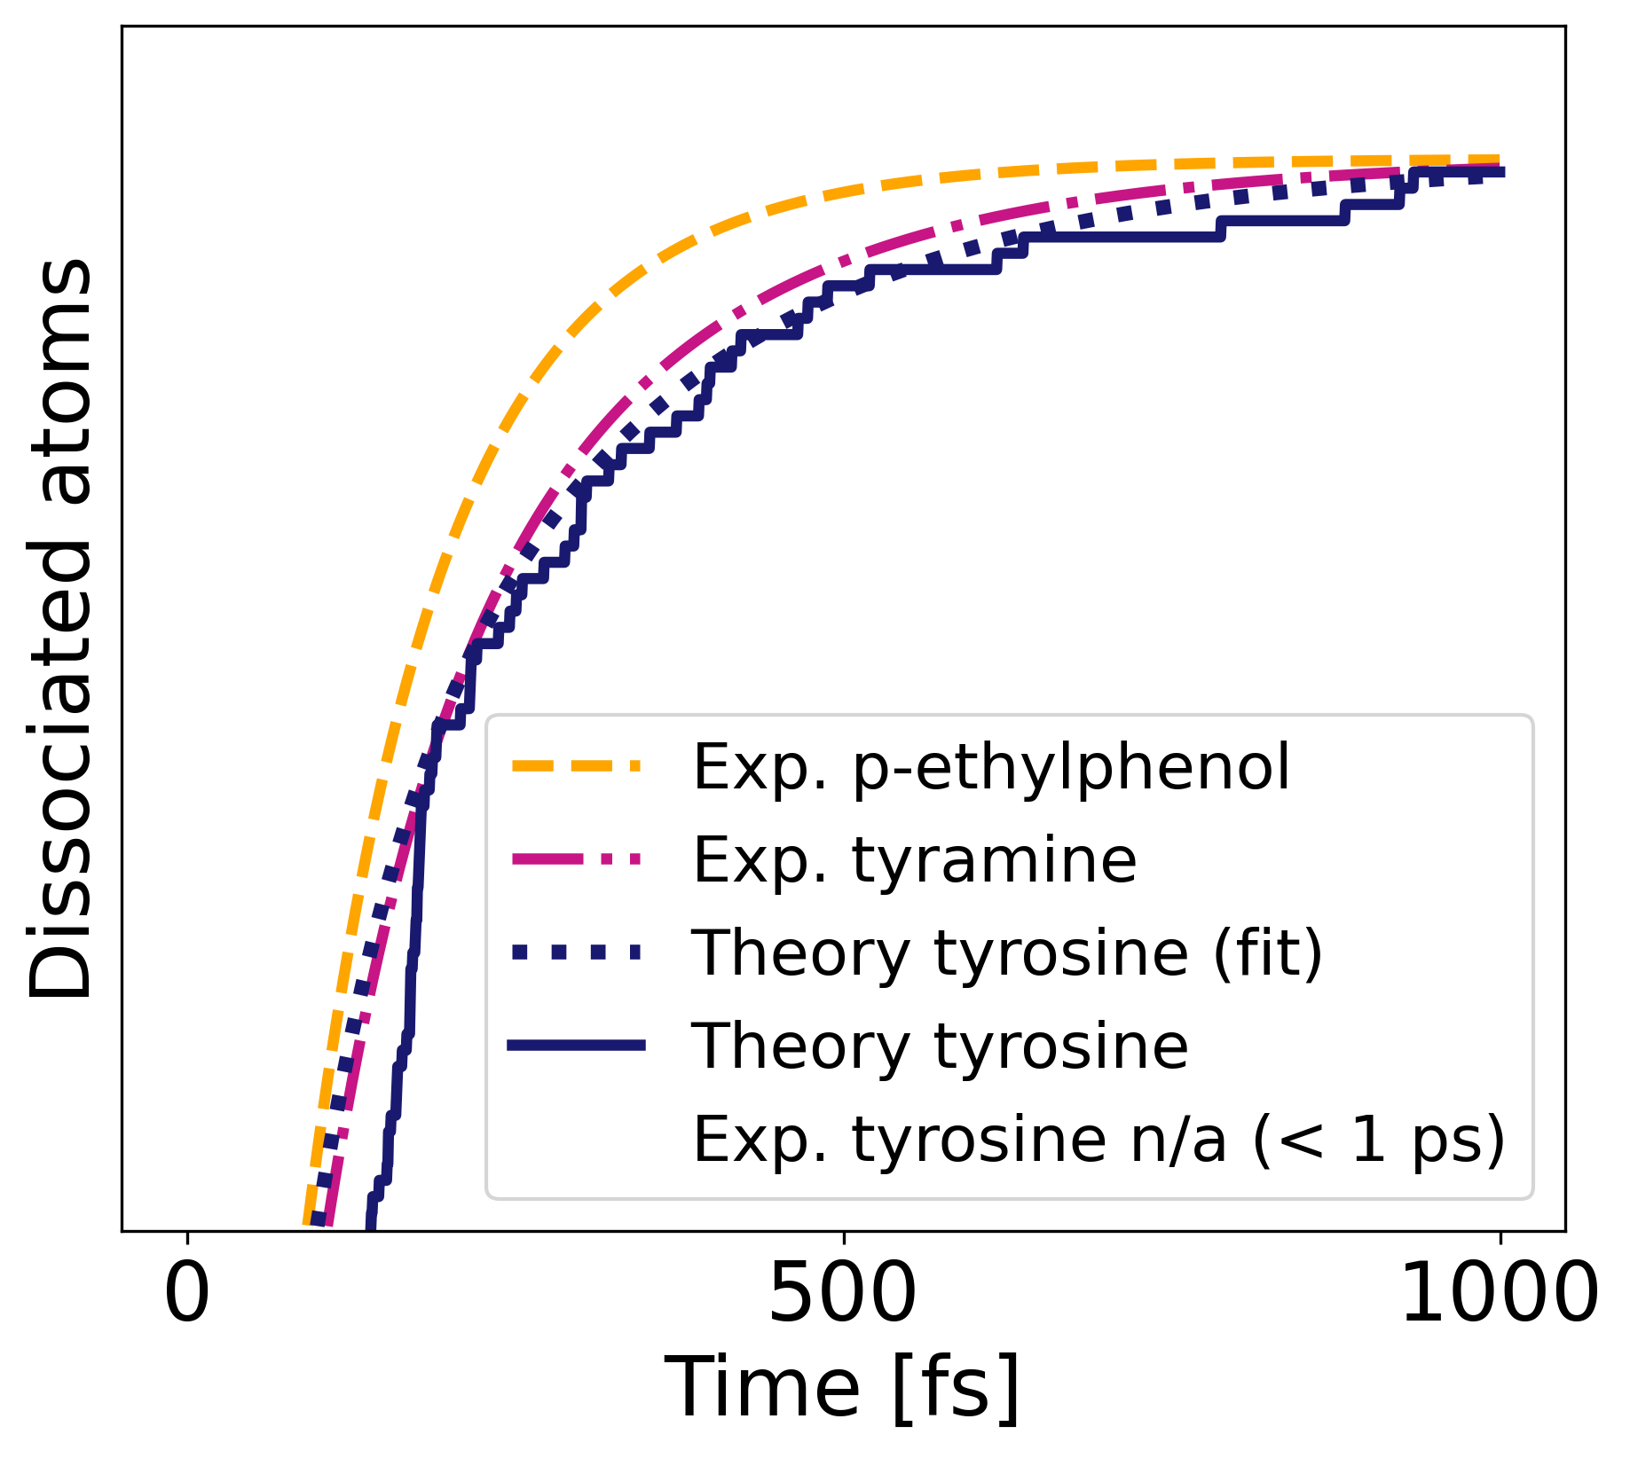
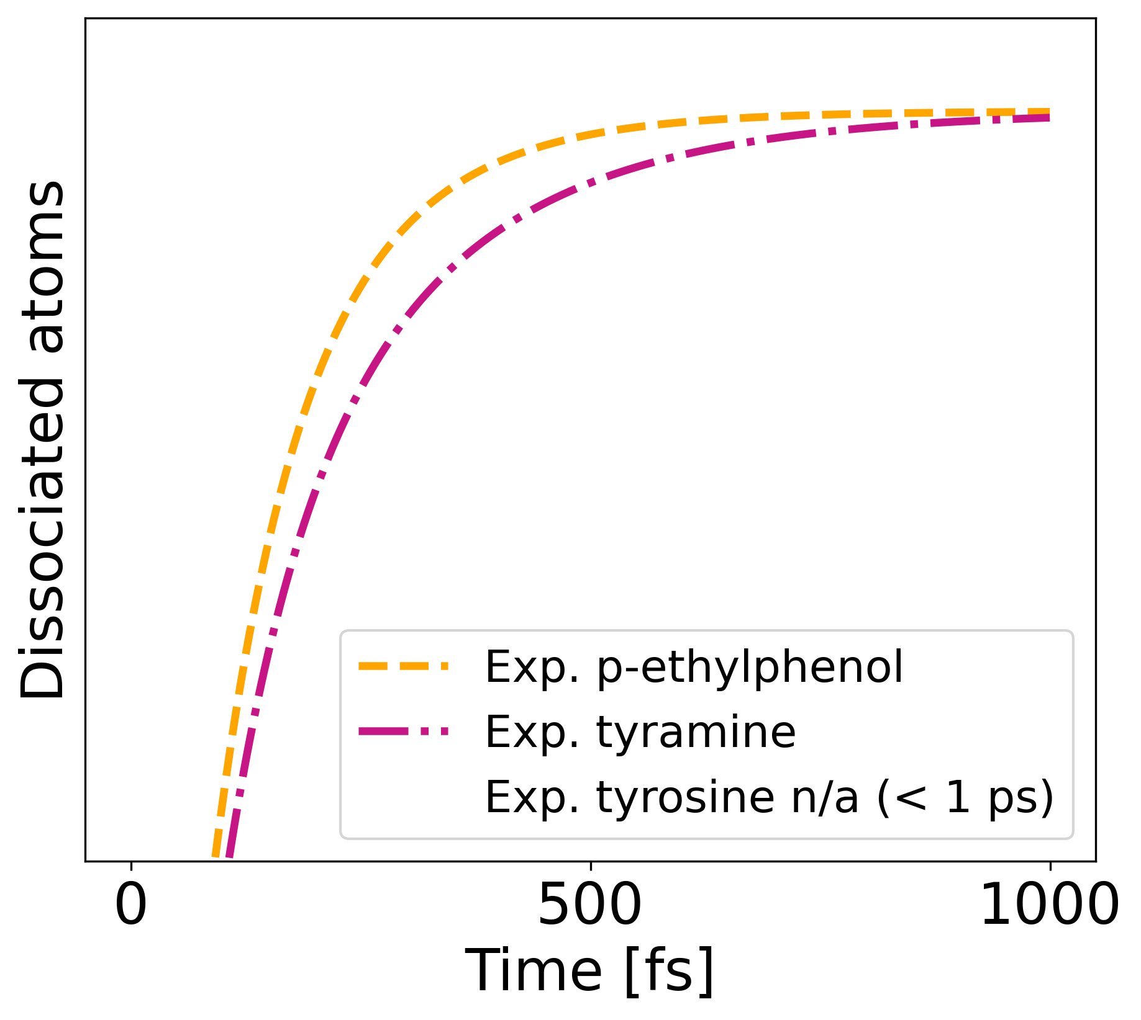
The dissociative ¹πσ* state
Stavros and co-workers:^{[1]}
Time-resolved pump/probe spectroscopy
+ velocity map ion imaging
Two reaction channels, ultrafast time scales (< 1 ps)
k (p-Ethylphenol) < k(tyramine) < k(tyrosine)
Photodynamics:
Tyrosine: k1 = 66±9 fs, k2= 237±77 fs
Fast channel: dissociation in ground state
Slow channel: dissociation in excited state
[1] A. Iqbal, V. G. Stavros, J. Phys. Chem. Lett.1, 2274–2278 (2010)
KER spectrum extracted from Ref. 1
J. Westermayr et al., unpublished (2021).
Notes:
Phenol photodissociation; C-C bond cleavage for p-2-aminoethylphenol; (200nm/240nm) pump/probe

Slide 21
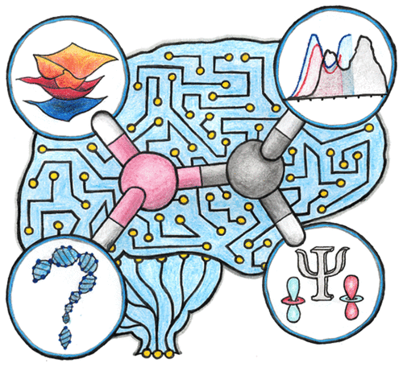
Conclusion
Photodynamics of tyrosine:
Power of theory: complement experiments, provide insights
How does this knowledge influence how we study peptides and proteins?
What is the influence of an environment?
Still many questions unanswered
ML for photodynamics simulations:
Can enable longer time scales
Describe more complex systems
Can help to interpret and analyze
(Extensive) review:
J. Westermayr and P. Marquetand
„Machine learning for excited states“,
Chem. Rev., doi:10.1021/acs.chemrev.0c00749 (2020)
Notes:
What I want you to take home is... Yet we are just at the beginning o funderstanding this exciting reaction mechanism and some of natures secrets

Slide 22
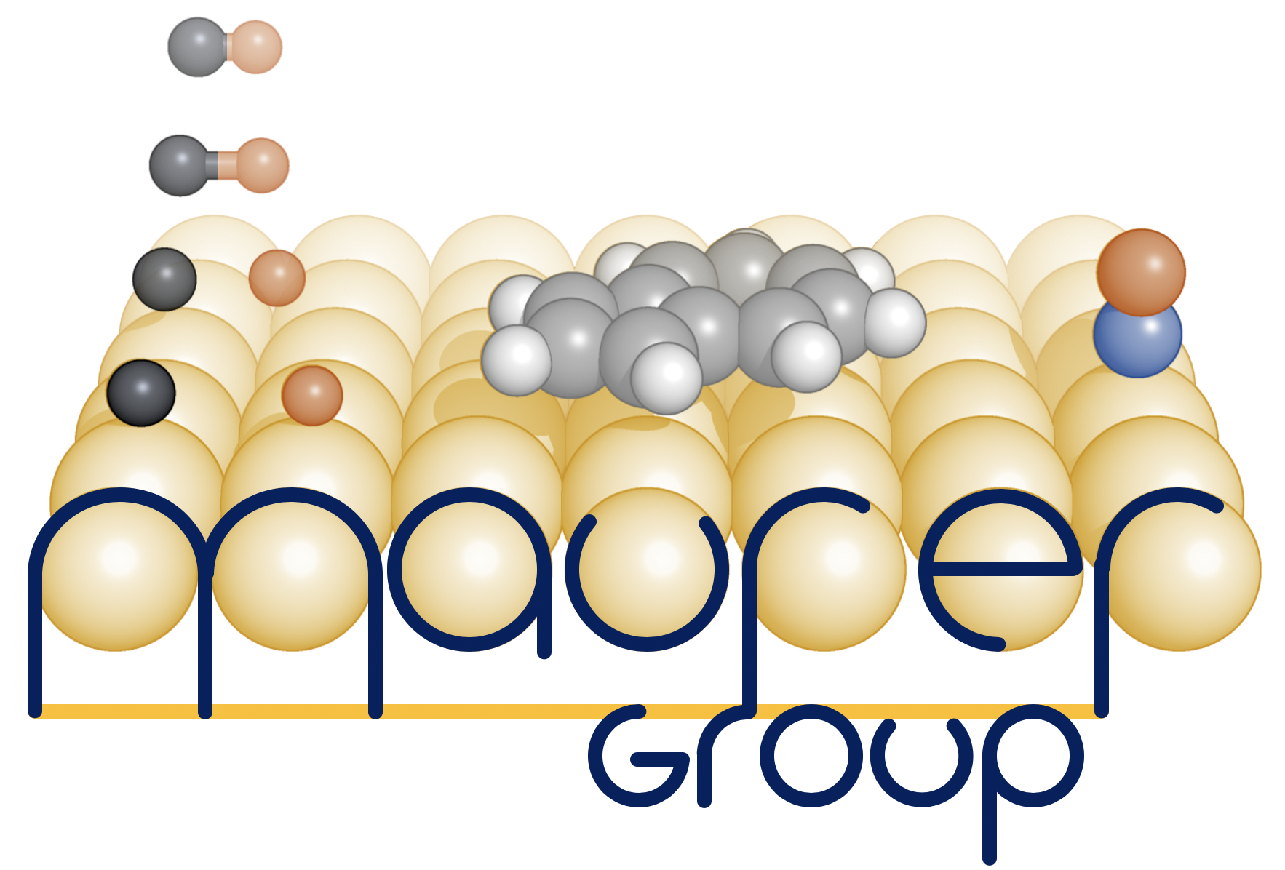
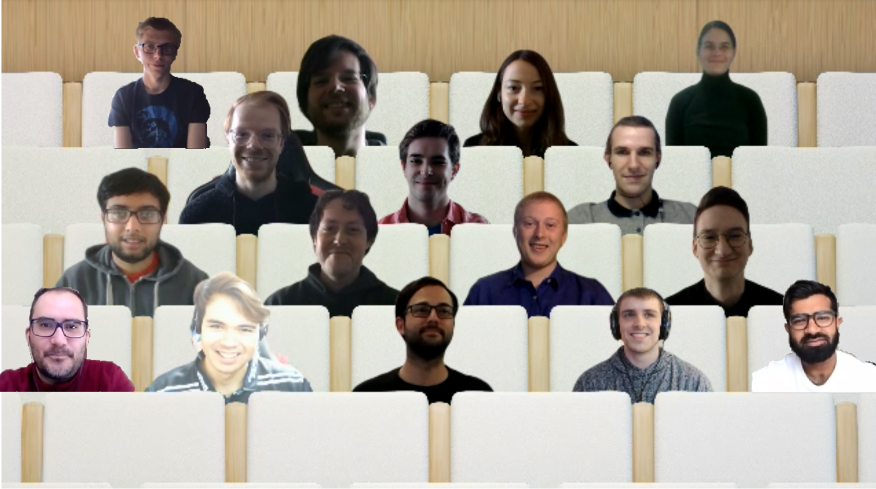




Thank you for your attention!
Priv.-Doz. Philipp Marquetand
Univ.-Prof. Leticia González
Dr. Michael Gastegger
Thank you for your attention
Any Questions?

Slide 23
Populations
ML predictions | Costs CPU (GPU)
Energies + forces | ~ 2 s (~ 0.1 s)
ML predictions | Costs CPU (GPU)
Energies + forces | ~ 2 s (~ 0.1 s)
Nonadiabatic couplings | ~ 15 min (~ 50 sec)
ML predictions | Costs CPU (GPU)
Energies + forces | ~ 2 s (~ 0.1 s)
Nonadiabatic couplings | ~ 15 min (~ 50 sec)
1 ps dynamics | up to 3 days
J. Westermayr et al., unpublished (2021).

Slide 24
Roaming in tyrosine
J. Westermayr et al., unpublished (2021).

Slide 25
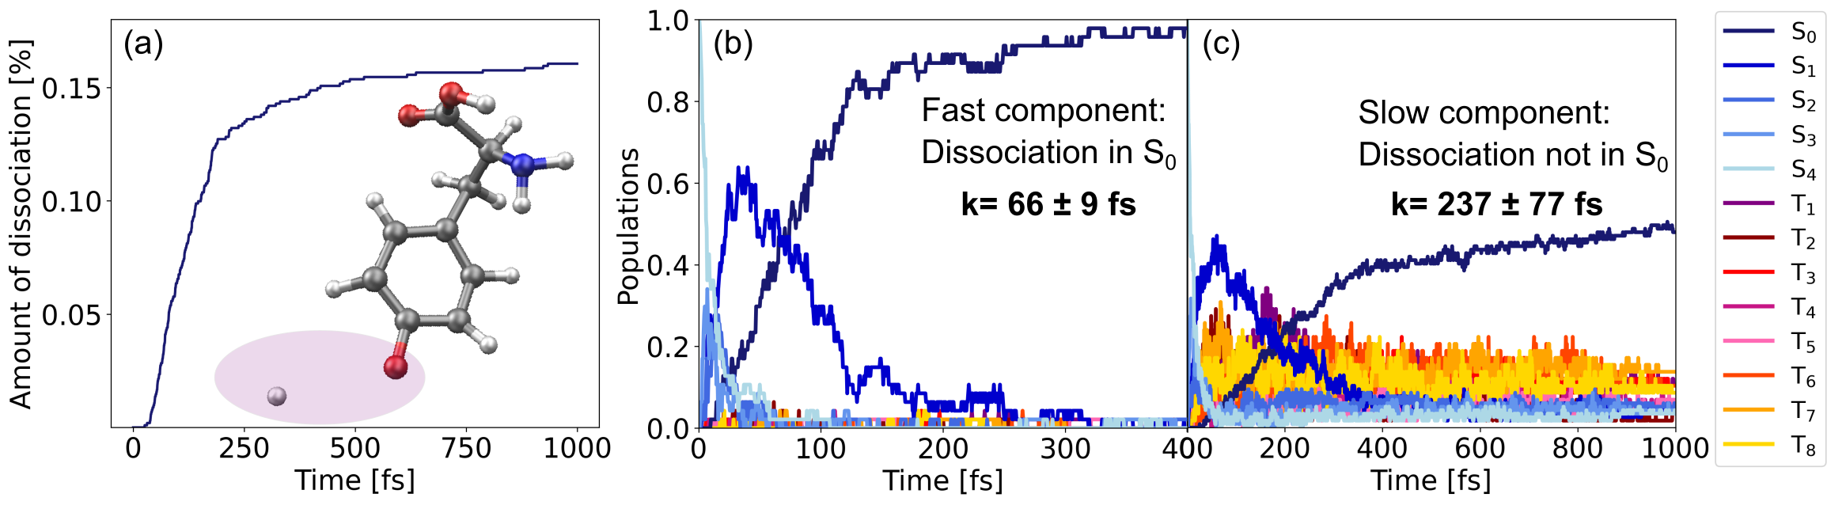
Kinetics
J. Westermayr et al., unpublished (2021).

Slide 26
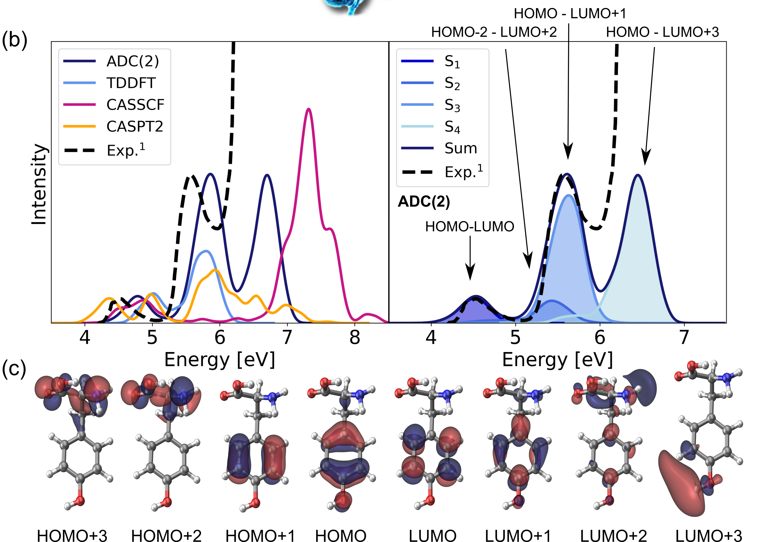
Comparison of methods

Slide 27
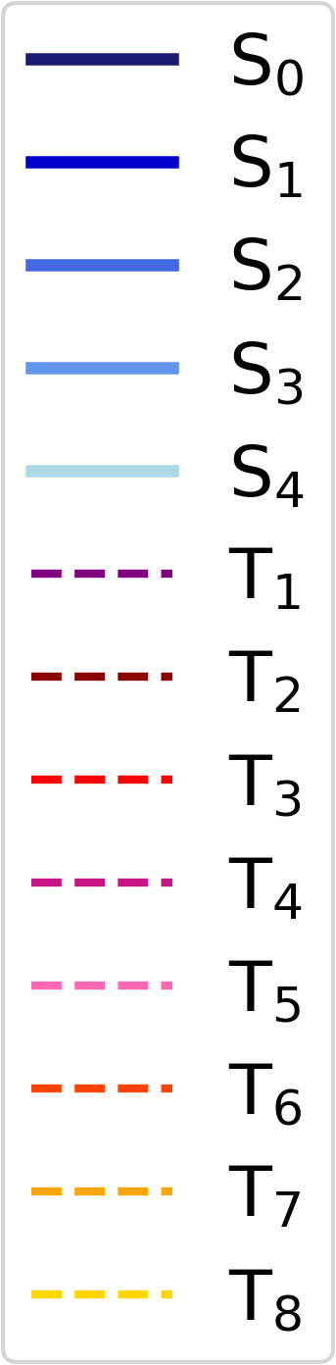
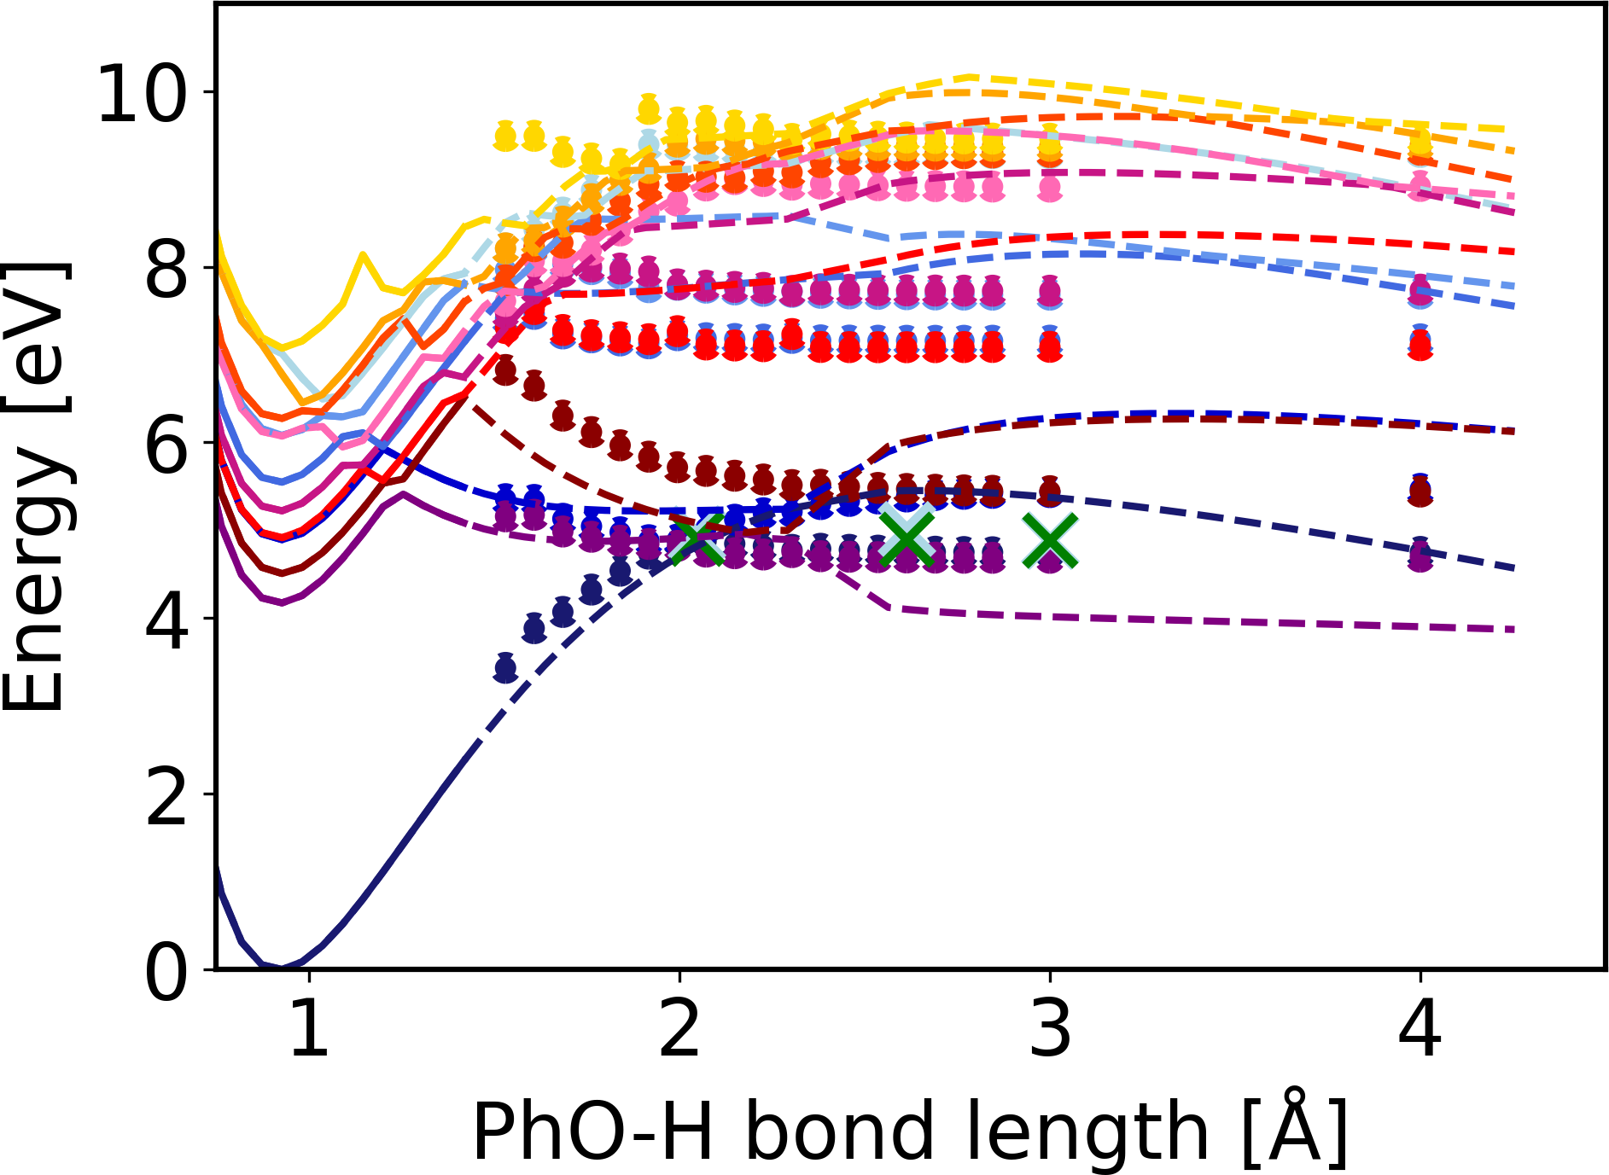
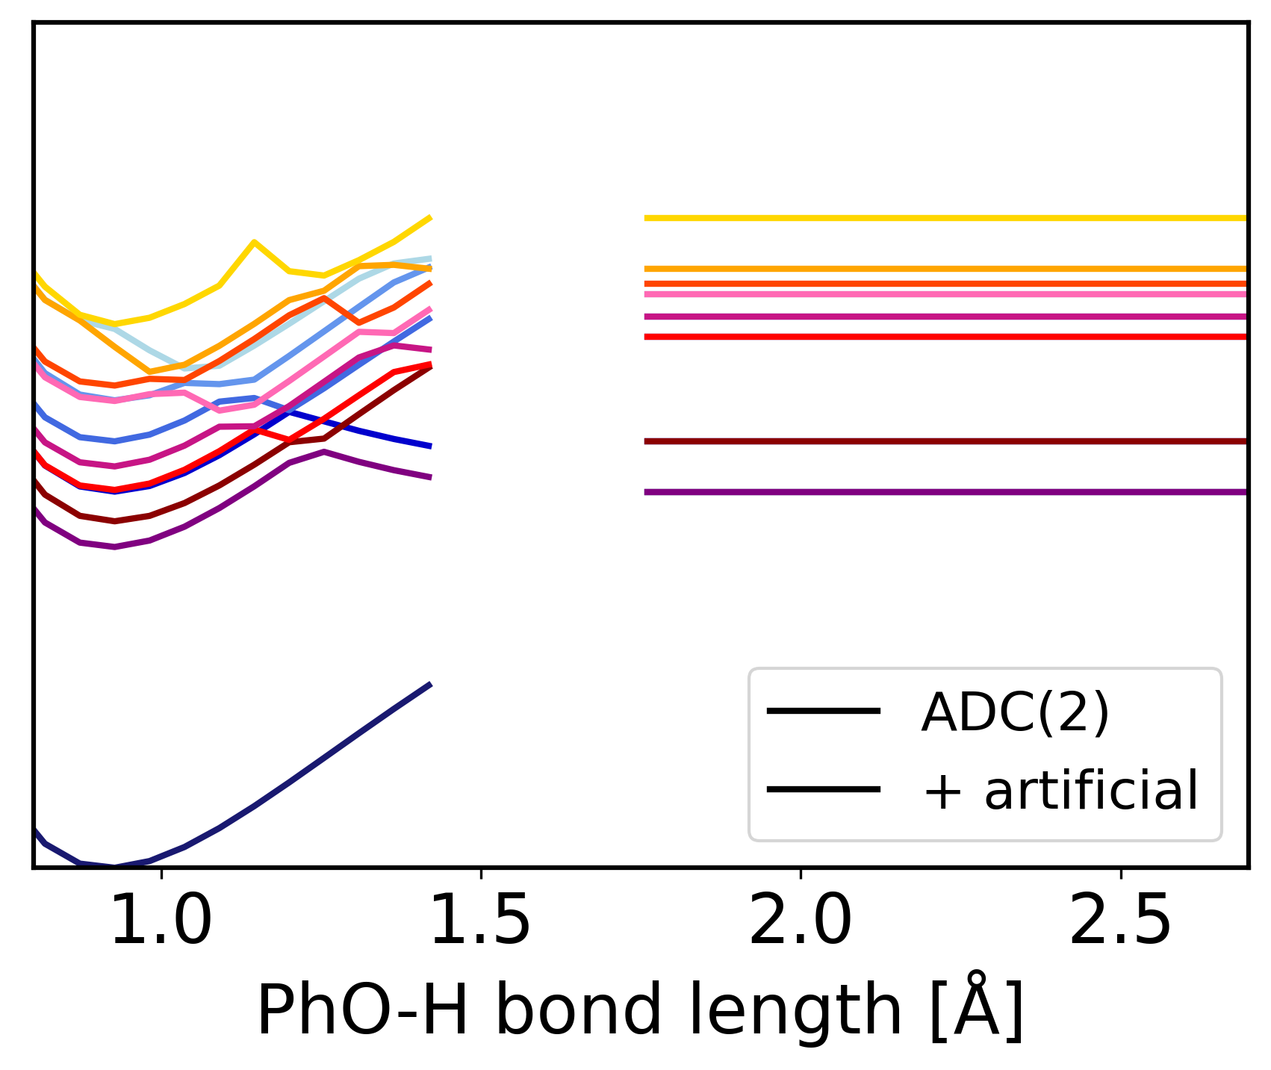
Artificial data

Slide 28
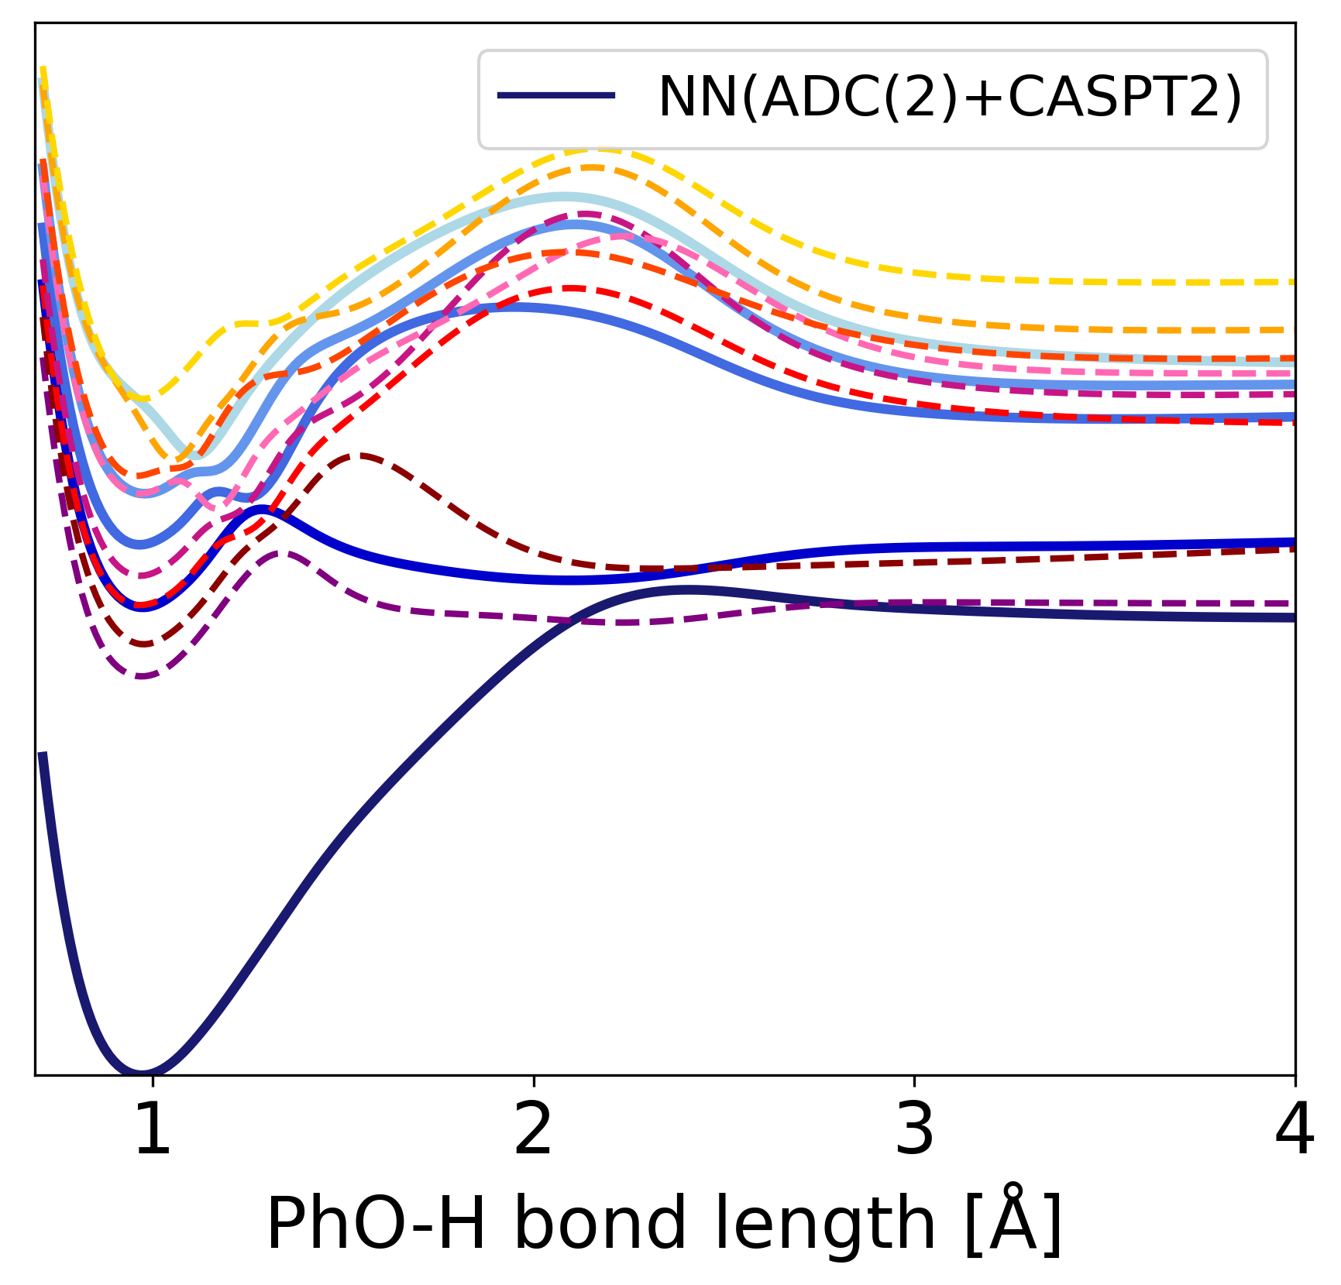
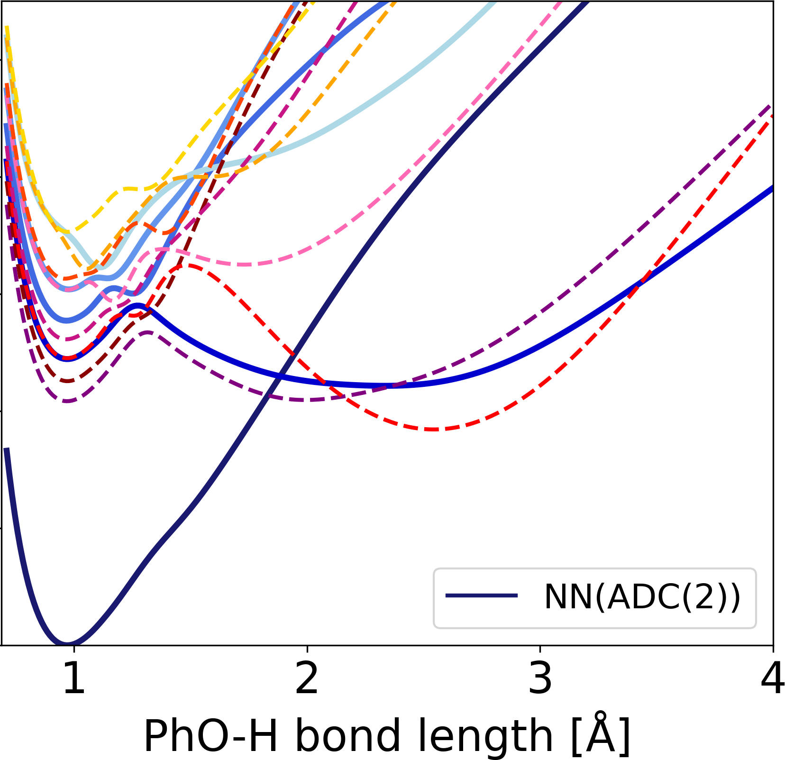
ML predictions

Slide 29


Phase correction
Phase correction
Initial ~16,500 data points
All phase corrected (using more states)
Additional data points were phasecorrected with ML

Slide 30

Validation of roaming

Slide 31

ML models

Slide 32

ML models

Slide 33

Training Set Generation
Adaptive sampling^{[1,2]}
Quantum
chemistry
ML dynamics
[1] M. Gastegger, J. Behler, P. Marquetand Chem. Sci. 8, 6924 (2017)
[2] J. Behler, Int. J. Quantum Chem. 115, 1032–1050 (2015)

Slide 34
Training Set Generation
Adaptive sampling^{[1,2]}
Re-training
of ML models
ML dynamics
[1] M. Gastegger, J. Behler, P. Marquetand Chem. Sci. 8, 6924 (2017)
[2] J. Behler, Int. J. Quantum Chem. 115, 1032–1050 (2015)

Slide 35
Training Set Generation
Adaptive sampling^{[1,2]}
Unexplored region
Re-training
of ML models
ML dynamics
[1] M. Gastegger, J. Behler, P. Marquetand Chem. Sci. 8, 6924 (2017)
[2] J. Behler, Int. J. Quantum Chem. 115, 1032–1050 (2015)
Notes:
But whyso difficult for the excited states and yet only shown for ground state?

Slide 36


NNs for excited states
Methylenimmonium (CH₂NH₂⁺)
NN
MRCI/aug-cc-pVDZ
Scan around conical intersection seam
J. Westermayr, M. Gastegger, M. Menger, S. Mai, L. González, P. Marquetand, Chem. Sci., 10, 8100-8107 (2019).
22

Slide 37



SchNarc ― phaseless loss
CH₂NH₂⁺
raw QC data
phase-corrected QC data
J. Westermayr, M. Gastegger, P. Marquetand, J. Phys. Chem. Lett., 11, 3828-3834 (2020).
22

Slide 38

SchNarc ― phaseless loss
raw QC data
phase-corrected QC data
J. Westermayr, M. Gastegger, P. Marquetand, J. Phys. Chem. Lett., 11, 3828-3834 (2020).
22

Slide 39






Phase-free training algorithm
$C_{ij}^{+}=$ $\left\langle | \left.\hat{C}\right| \right\rangle$
$$C_{ij}^{−}=\left\langle | \left.\hat{C}\right| \right\rangle$$
$$E_{ij}^{+}={\left(C_{ij}^{ML}+C_{ij}^{QC}\right)}^{2}$$
Minimum
function
$$E_{ij}^{−}={\left(C_{ij}^{ML}−C_{ij}^{QC}\right)}^{2}$$
Training independent of sign of the couplings
Training on raw data possible
Reduction of cost of training set generation

Slide 40
Representation of molecules
Molecule-wise descriptor
Atom-wise descriptor
E_{A}
E

Slide 41


Fitting dipole moment vectors
Absorption proportional to oscillator strength
Charge model for fitting
$f^{osc}=\frac{2}{3}∆E_{ij}|μ_{ij}|²$
What the model builds
without knowing
What we
learn
q_{i,a} … atomic charge of state i
r_{a}^{CM} … distance of atom a to the center of mass (CM)
[1]Michael Gastegger, Jörg Behler, Philipp Marquetand, Chem. Sci. 8, 6924-6935 (2017)
[2] Julia Westermayr, Philipp Marquetand, J. Chem. Phys. 153 (15), 154112 (2020)

Slide 42
Representation of molecules
Molecule-wise descriptor
Atom-wise descriptor
E_{A}
E_{B}
E

Slide 43


Representation of molecules
Molecule-wise descriptor
Atom-wise descriptor
E_{A}
E_{B}
$⋮$
E_{N}
E
E
Only for molecules of same size
For molecules of any size and atom type
Atomic properties

Slide 44
SchNet
(Z_{A} … Z_{N}), (r_{A}… r_{N})
Deep continuous-filter convolutional layer neural network
Learns molecular representation based on inter-atomic distances and atom types
Originally developed for ground-state properties
Descriptor generator
Descriptor
Prediction block
E
K. T. Schütt, P. Kessel, M. Gastegger, K. A. Nicoli, A. Tkatchenko, and K.-R. Müller., J. Chem. Theory Comput., 15(1):448–455, (2019).

Slide 45


Phase correction^{[1,2]}
Initial Data
Potential 2
Train $≥$2 ML models
Potential 1
Molecular
dynamics
Potential 2
Models diverge?
Models diverge?
Yes
Phase correction^{[2,3]}
Reference calculations
Models diverge?
Prediction
Couplings:
quantum chemistry output
Prediction
ML 1
ML 2
STOP
Prediction
ML 1
ML 2
STOP
ML 1
ML 2
STOP
Time
Time
Reaction coordinate
No
Converged ML potentials
[1] J. Westermayr, et al. Chem. Sci.,10, 8100-8107 (2019).
[3] A. V. Akimov, J. Phys. Chem. Lett., 9(20), 6096.6102 (2018).

Slide 46

Phase correction^{[1,2]}
Initial Data
Machine learning potentials: smooth functions!
Solution: make couplings smooth
Potential 2
Train $≥$2 ML models
Potential 1
Molecular
dynamics
Potential 2
Models diverge?
Models diverge?
Yes
Phase correction^{[2,3]}
Reference calculations
Models diverge?
Prediction
Couplings:
quantum chemistry output
Prediction
ML 1
ML 2
STOP
Prediction
ML 1
ML 2
STOP
ML 1
ML 2
STOP
Time
Time
Reaction coordinate
No
Converged ML potentials
[1] J. Westermayr, et al. Chem. Sci.,10, 8100-8107 (2019).
[3] A. V. Akimov, J. Phys. Chem. Lett., 9(20), 6096.6102 (2018).

Slide 47


Phase correction^{[1,2]}
Initial Data
Phase correction:
Pre-processing of data via wave function overlap computations
Phase-free training algorithm
Potential 2
Train $≥$2 ML models
Potential 1
Molecular
dynamics
Potential 2
Models diverge?
Models diverge?
Yes
Phase correction^{[2,3]}
Reference calculations
Models diverge?
Prediction
Phase corrected
Prediction
ML 1
ML 2
STOP
Prediction
ML 1
ML 2
STOP
ML 1
ML 2
STOP
Time
Time
Reaction coordinate
No
Converged ML potentials
[1] J. Westermayr, et al. Chem. Sci.,10, 8100-8107 (2019).
[3] A. V. Akimov, J. Phys. Chem. Lett., 9(20), 6096.6102 (2018).

Slide 48
Training Set Generation
1
Initial sampling
Scan along normal modes
Scan along dihedral angle

Slide 49

Training Set Generation
Scan along normal modes
Scan along dihedral angle
1
ML 1
ML 2
STOP
Predicted property
Time

Slide 50


Slow population transfer: CSH₂

Slide 51


Slide 52


Slide 53



Surface hopping molecular dynamics
Energies
Forces
Couplings
Electronic structure
Molecular dynamics program SHARC
Classical
propagation
t = 0.5 fs
t = 1.0 fs
t = 1.5 fs
t = 2.0 fs
t = 2.5 fs
t = 3.0 fs
S. Mai, P. Marquetand, L. González, WIREs Comp. Chem. e1370 (2018); https://sharc-md.org/

Slide 54
Surface hopping molecular dynamics
Energies
Forces
Couplings
Electronic structure
Molecular dynamics program SHARC
Classical
propagation
t = 0.5 fs
t = 1.0 fs
t = 1.5 fs
t = 2.0 fs
t = 2.5 fs
t = 3.0 fs
S. Mai, P. Marquetand, L. González, WIREs Comp. Chem. e1370 (2018); https://sharc-md.org/

Slide 55
Surface hopping molecular dynamics
Energy
Mixed quantum-classical
Nonadiabatic transitions
Quantum chemical potential energy surfaces
Molecule: moves classically
Reaction coordinate

